Slide 1
Size exclusion chromatography to isolate EVs
Pietje Puk
White forest hospital
April 13th 2021

Slide 2
Overview of size exclusion chromatography (SEC)
Separates particles based on size
Results in two size-based fractions
≤ 10 minutes
EV recovery: ≤50% [1]
EV enrichment: 20-fold relative to HDL, 500-fold [1,2] relative to proteins
Negligible shear stress

Slide 3
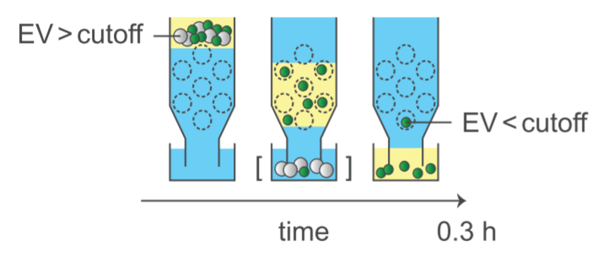
Working principle size exclusion chromatography

Slide 4
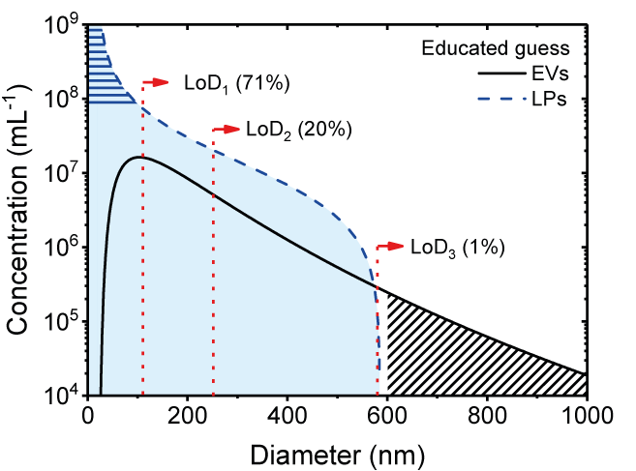
Working principle size exclusion chromatography
Size cut-off

Slide 5
Isolation performance
EV recovery
  Depending on selected fractions, ≤50% [1]
EV enrichment
  20-fold to 25-fold relative to HDL [1]
  400-fold to 500-fold relative to proteins [1,2]

Slide 6
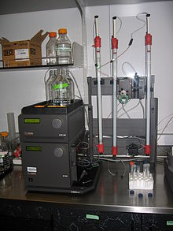
Practical information
Time required per sample: 10 minutes
Autosampler and auto fraction possible
Scalable to industrial applications

Slide 7
Quality controls
Which quality controls are needed to validate results
  For example?

Slide 8
R&S of data reporting
What should minimally be reported to generate reproducible data? (what is typically not reported)
  Settings
  Calibrations
  Quality controls
  Refer to available reporting frameworks (e.g. MISEV)
How should data not be reported
  Provide examples

Slide 9
Do’s and don’ts

Slide 10
Good examples

Slide 11
Future developments

Slide 12
References
First author et al. Journal Year <+ hyperlink>
First author et al. Journal Year <+ hyperlink>

Slide 13
Definitions
EV enrichment: ratio of EV purity before and after isolation
EV purity: ratio between EVs and non-EV components
EV recovery: percentage of total EVs preserved after isolation
In case EV recovery >100%, isolation method concentrates

